Slide 1
Thermo-Medico Patient Mattress cum Blanket
Sakshi Goyal – EN- 3rd Year – 9146955570 – goyalss@rknec.edu
Saurabh Shrivastava – EN – 3rd Year -
Sushrut Kotwaliwale – EN – 3rd Year -
Mentor: Prof. S Admane
(Electronics Department)
Date: 1 August 2020

Slide 2

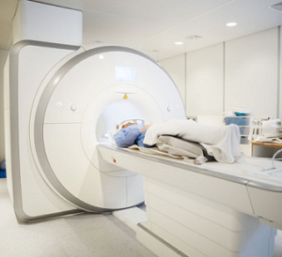
Market Pain
MRI rooms are kept cold because ideal temperature to operate MRI is 17 to 21 degree C and at higher temperatures it may malfunction.
This temperature being lower than the normal human body temperature of 34 degree C calls for all the trouble.
Thus patients going through mri scanning often shiver which further leads to disturbance in imaging.
Sometimes patients in PET, CT Scan rooms or in ICU also feel cold and a normal blanket can’t help them.
Source: Schneider Electric Blog
Problem statement proposed by GE Healthcare in Hackathon 2020
2

Slide 3
Technology/Process Solution
Picture
An electronically heating - MRI compatible warm patient mattress/ blanket.
No MRI compatible heating product has been manufactured till now.
Existing solution is nothing but providing blankets to the patients but our product is customized to maintain the temperature and trap the body heat of patient along with not disturbing the room’s cold temperature.
All the materials used are researched and then taken in consideration in order to be compatible to a 1 – 1.5 Tesla strong magnetic field.
Source: Mentioned in detail later along with specific material used.
3

Slide 4
Value Proposition
Two Medico-Thermo blankets will suffice the average need of MRI scans per day i.e. 22.5.
The product is made keeping in mind the range of duration of scanning from 15 min to 90 min.
Reasonable, Light weight, One time investment, long life and low maintenance are the key features of our product.
Source: NHS article
4

Slide 5
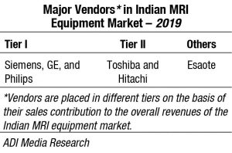
Market
The Indian MRI equipment market for 2019 is estimated at Rs 1778.5 crore, and 290 units, by volume. It continues to be dominated by Siemens, GE, and Philips.
Source: Medical Buyer Artcle- https://www.medicalbuyer.co.in/government-the-savior-of-mri-market-2/#:~:text=Indian%20market,Siemens%2C%20GE%2C%20and%20Philips.
5

Slide 6
COMPETITORS
We didn’t find any such research or product being discussed on this topic and the problem statement too was proposed by MRI machinery manufacturing company itself.
It’s may be due to the fact that hospitals don’t actually realize the problem faced by patients and think that normal blankets should serve the purpose.
6

Slide 7
Channels (Marketing)
The MRI machine and other medical equipment manufacturing companies should be the main target as they would then further supply our product to their hospital customers.
Personal networking through emailing, writing blogs and creating website and publishing in newspapers would surely gather the attention of big medical companies.
It’s a business to business type of business where in we do not provide our product directly to the customers (patients) .
7

Slide 8
Funding Support Required
Put down the cost structure required to implement the idea/making prototype/MVP

Slide 9
Current Development Status of Innovation
What is the current development status
Time period in months required for innovation to be completely developed for field testing/ intended end –user
Prototyping Detail (If any)
Objective of prototype making.

Slide 10
Team
Name: Sakshi Goyal
Branch: Electronics
Mobile No: 9146955570
Email : goyalss@rknec.edu
Name:
Branch:
Mobile No:
Email :
Name:
Branch:
Mobile No:
Email :

Slide 11
Detailed Solution Idea

